Slide 1
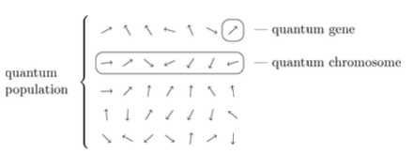
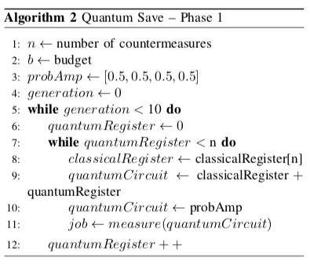
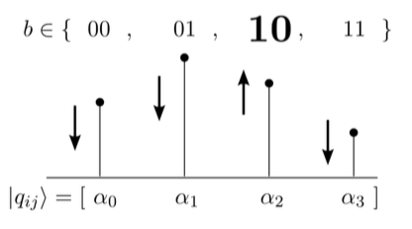
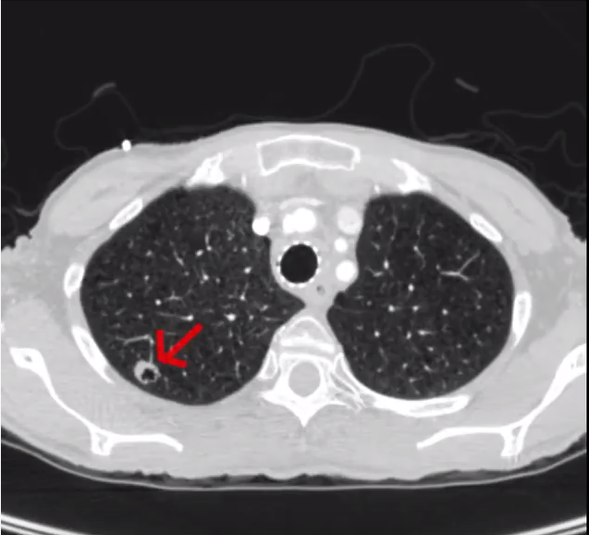
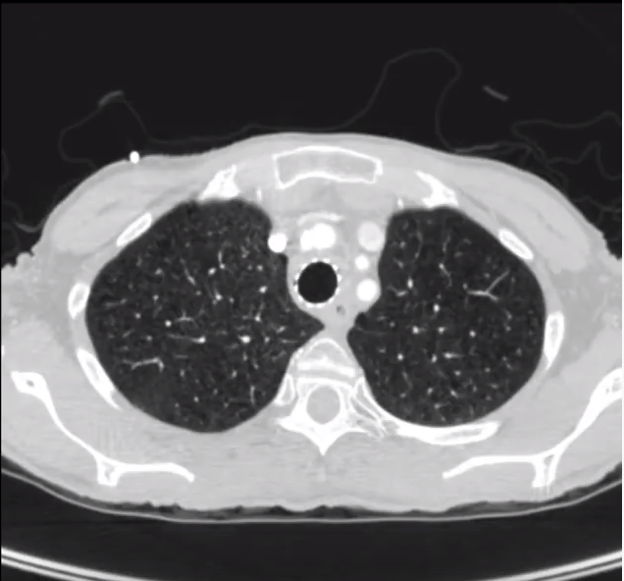
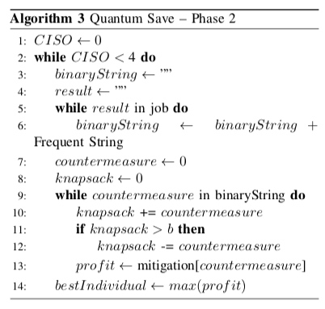
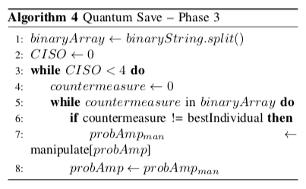
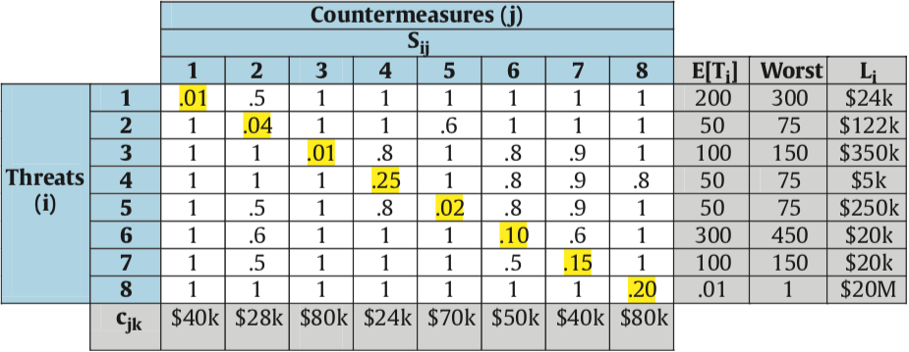
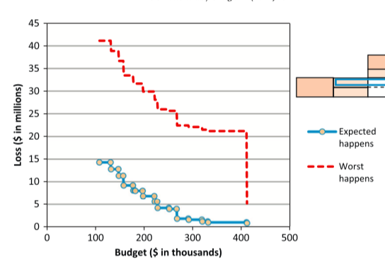
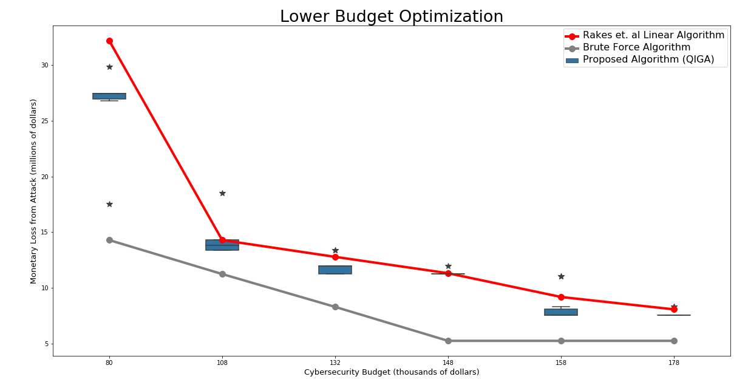
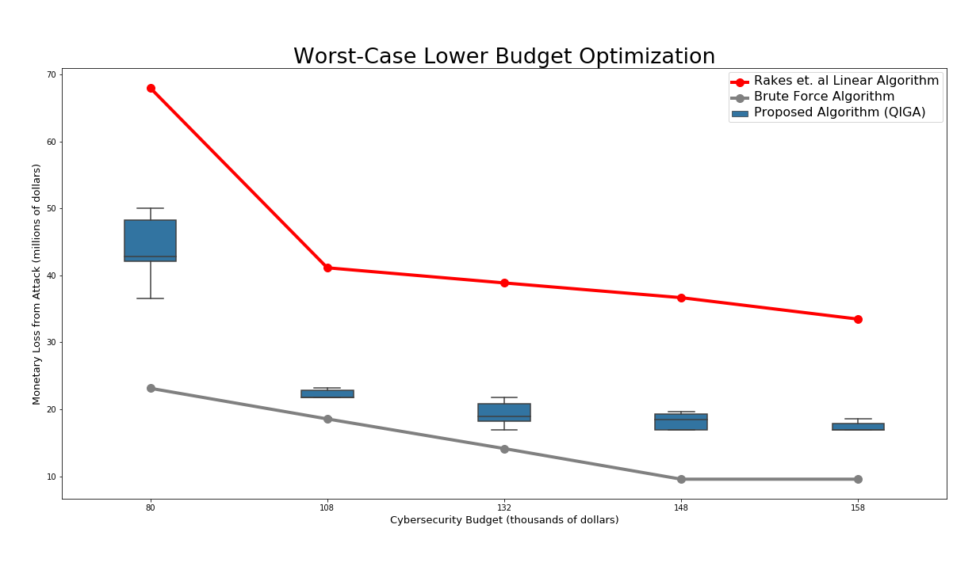
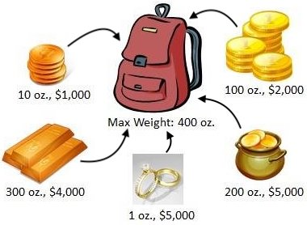
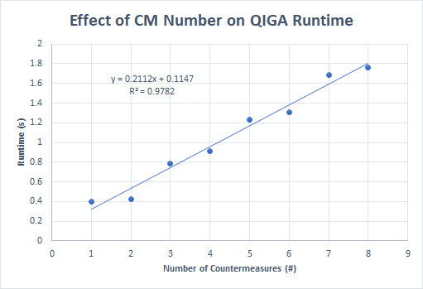
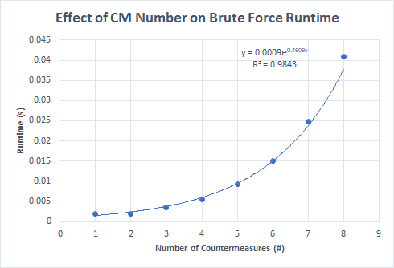
A Quantum Computer’s Guide to Saving Money
Using a Quantum Genetic Algorithm to Optimize the Allocation of Cybersecurity Budget
The Value of Data – Financial Ruin
Quantum Genetic Algorithm
Results -- Theoretical Proof
The Quantum Population
Random Variability
Survival of the Fittest
Lemma: Quantum Save can allocate budget, b, when choosing from countermeasures with input-size, n, in O(n) time complexity with a linear time oracle for quantum measurement of a single register.
Countermeasure
After the population is created, the second aspect of Darwin’s Theory of Natural Selection is random variation in genetic traits.
If every generation contained the same traits, then evolution would never occur.
Instead, mutations and gene crossovers drive natural selection.
The reproduction process consists of a high-degree of randomness which is often difficult to replicate in a genetic algorithm without extensive hyperparameter tuning.
This is where quantum computing significantly enhances the speed and accuracy of a genetic algorithm
The Power of the Qubit
A bit is isolated to 0 or 1,
but a qubit is the infinite
states between 0 and 1
Each qubit is
initialized with a 50%
chance of returning 1
and a 50% chance of
returning 0
As the algorithm progresses, the probabilities change, with a potential 90% chance of returning 1 and a 10% chance of returning 0.
This change is controlled by manipulating the probability amplitudes of each qubit or qubit register in the population
In a classical genetic algorithm, random variation is controlled by unique hyperparameters
However, by using quantum computing, the random variation is inherent
The measurement value of a qubit is never concrete but fluctuates based upon probability amplitudes
The IBM Quantum Simulator
Uses a dilution refrigerator to suspend an electron
The measurement of the electron is then simulated
If the electron is spin-up, the qubit returns a zero
If the electron is spin-down the qubit returns a one
Finding the Best Individual
Once the population is created and initialized with the probability amplitudes, each recommendation strategy developed by a CISO is analyzed
The CISO strategy that results in the least cybersecurity loss is recorded as the best individual
The best individual is used as a point of comparison for the rest of the algorithm
Line 1: the number of countermeasures is defined.
Depends upon the input-size of the recommendation list = O(n) complexity
Lines 2 – 4: basic Quantum Save variables defined.
Variables are not correlated to the input-size = O(1) complexity
Lines 5 – 6: start of Quantum Save
Loops through the number of generations (constant)
Quantum registers initialized.
O(1) complexity
CISO
Think Tank
The Value of Data – Life or Death
Quantum Population Specifics
The quantum population is created on the IBM Q32 simulator using the IBM Qiskit API
Why a Quantum Simulator instead of a Quantum Computer?
COMPUTER: Can only maintain a quantum state for a short period of time before quantum decoherence.
SIMULATOR: Can simulate a quantum state for an extended time period
In the future, Quantum Computers can maintain superposition and algorithms, like Quantum Save, can be transferred onto these new devices.
Each population uses an array of 32 qubits arranged in 4 rows and 8 columns to simulates a Think Tank
The goal of this Think Tank is to create a recommendation list of 8 countermeasures that US companies can implement
ROW: Corresponds to a Chief Security Officer in this hypothetical Think Thank
COLUMN: Corresponds to a potential countermeasure on the recommendation list
Linear Superposition
After the creation of the population, each qubit is measured and assigned a binary value, either 0 or 1.
If the qubit is measured as a 1, then the countermeasure is added to the recommendation list
If the qubit is measured as a 0, then the countermeasure is removed from the recommendation list
Depending on the values of the qubits in each row, the CISO puts together the list
How difficult is it for a doctor to tell a patient that he or she is dying from lung cancer?
The patient did everything right. CT Scans from early screening came back as normal
Malware manipulated the CT scan causing a misdiagnosis of the patient
Israeli Researchers Mirsky et al. investigated this growing fear by successfully infiltrating a hospital network, intercepting CT Scans, and manipulating them.
Exploited one of five potential
weaknesses in the infrastructure
Used a CT-GAN to cover
up and introduce cancerous
nodules in lung scans
Success rate is 99.2% for cancer
injection and 95.8% for cancer
removal
With malware, hackers can not only
steal your personal information, but also have your life in their hands
Line 7: second loop iterates through every quantum register. Quantum registers depend on the input size = O(1) complexity.
Lines 8 – 11: Quantum circuit created and measured. Measurement of a single register is independent of input-size = O(1) complexity.
Normal Image
Altered Image
2. Evolving the Population
The recommendation list on the best individual is iterated through and compared to the recommendation list on the other CISO’s in the Think Tank
This is done sequentially.
The first countermeasure on the best individual’s list is compared to the first countermeasure on all other CISO lists
The iteration looks at the qubit value (1 if the countermeasure is included and 0 if the countermeasure is excluded)
Depending on the value of the qubit, the probability amplitude (% chance of getting 1 or 0) of the other value is decreased
If the best individual implemented the countermeasure, the algorithm increases the probability that all other CISO’s implement the countermeasure
Probability amplitudes are chanced so that the sum of all probabilities remain equal to 1.
Lines 1 – 2: start of phase 2 of Quantum Save
CISO Variable Initialized
CISO’s in think-tank looped through (constant number)
O(1) complexity
Line 5: iterate through results of quantum measurement
Job string dependent on input-size = O(n) complexity
Line 9: iterate through countermeasures in the input array
Input array directly correlates with input-size = O(n) complexity
Consolidating Cybersecurity Data
In wake current attacks, third-party organizations like KnowBe4 publish statistics on the specifics of each attack in Endpoint Protection Reports.
Rakes et al. used one of these reports to compile a dataset with three major parts:
1. Survival Probabilities – Array in White
Survival probability, P(X, Y) is the probability of an attack (X) succeeding when a countermeasure (Y) is implemented
2. General Statistics – 3 Grey Columns
Expected number of attacks in a year, E[T_{i}]
Worst-case number of attacks in a year
Damage incurred from of a
successful attack, L_{i}
3. Countermeasure Price
The grey row at the bottom
of the table
The price of installing each
countermeasure
Line 14: the maximum profit value is determined. Number of CISO’s remain constant = O(1) complexity
Quantum Save Can Help Hospitals and Defense Contractors Save MILLIONS by Allocating the Budgets of Small and Medium Sized Firms!
Previous Research
Using the compiled cybersecurity data,
Rakes et al. developed a linear
optimization model with:
INPUT: Company’s Budget
OUTPUT: Expected Damage
in the Case of an Attack
The linear optimization model followed
three major steps in order to allocate
the budget effectively:
Proportion of Surviving Threats
The proportion (P_{i}) of threats that survive if countermeasure j is implemented at level k
Each countermeasure has an effectiveness (e_{jk}) and a decision variable (Y_{jk})
P_{i} = ∑ (1 – Y_{jk} e_{jk})
Damage to Company by Surviving Threats
The monetary loss (both explicit and implicit) from the surviving threats after a countermeasure is implemented
Loss = P_{i} * L_{i} * E[T_{i}]
Cost of Implementing Countermeasure
Cost = ∑ c_{jk} * Y_{jk}
The total cost of all countermeasures must remain under a certain budget, B.
The model works better for higher budget firms NOT small to medium sized enterprises
Proof: After looking at the three algorithmic blocks, it was noticed that the algorithm was split into 5 different section. When analyzing each of the 5 major sections of Quantum Save, it was concluded that the time complexity is O(n). Quantum Save was able to achieve linear time complexity by taking advantage of quantum computing.
Results -- Accuracy
Conclusion
Budget | Improvement (%)
80k | 17.48
108k | 0.24
132k | 6.53
148k | 0.05
158k | 9.19
178k | 4.42
When looking at the expected case, a simple eye test suggests that Quantum Save performed better when compared to previous research.
Extent of that improvement varied by a decent margin
To confirm that the improvement wasn’t due to random variability, I looked at the distribution of outputs at each budget range
Outliers were determined at 95% confidence level or 1.57 IQR from the median
However, expected case can only provide so much information: WORST case is a better indicator of the effectiveness of an algorithm in budget allocation.
Extent of improvement varied by a significant margin
Since Quantum Save performed better in the worst-case, it will be more effective in the real-world where companies need to prepare for the worst-possible outcome
To confirm that the improvement wasn’t due to random variability, I looked at the distribution of outputs at each budget range
Budget | Improvement (%)
80k | 35.80
108k | 46.85
132k | 50.44
148k | 50.32
158k | 47.87
178k | 56.97
When looking at the distribution of my algorithm’s output at each budget (barring outliers), my algorithm performed better than or equal to previous work
Better is quantified as the algorithm that chose countermeasures that resulted in LOWER cybersecurity loss
When looking at the distribution of my algorithm’s output at each budget (barring outliers), my algorithm performed better than previous work in this field.
There is a significant jump between lower-budget optimization in the worst-case when compared to the expected case
Likely because the Knapsack problem looks at the scenario of budget allocation from a different angle.
A Unique Solution
This is a classic example of the Knapsack Problem
What is the Knapsack Problem?
An NP-Complete Problem where a certain value is
maximized while remaining under a certain budget
In the application of cybersecurity, the amount of money
saved is maximized but the company is forced to remain
under a budget constraint
Quantum Computing– The New Solution
A quantum algorithm can break a 2048 RSA encryptions in a matter of seconds
But now, this emerging technology in cybersecurity can be used to defend against potential attacks
Quantum Computing could be used to optimize the Knapsack Problem and allocate cybersecurity budgets more effectively
My algorithm had better accuracy when compared to that of previous research
Results -- Experimental Time Complexity
References
Any good algorithm finds a way to balance the trade-off between accuracy and time complexity.
Algorithms that are the most accurate often take the longest time to run
Algorithms that run very quickly are often the least accurate models of the situation
To find the time-complexity of my algorithm, I started looking at experimental data of how the input size (number of countermeasures) affected run-time.
I then compared the runtime patterns found in my algorithm to the runtime patterns found in brute force (a known algorithm with exponential time complexity
Again, experimental data was collected on the relationship between input size and runtime for a brute force algorithm
From a preliminary analysis, and an R-squared value as a metric, it appears that brute force scales exponentially
This confirms the theoretical research performed about the scalability brute force algorithms
Experimental data was collected on the relationship between input size (number of countermeasures) and runtime
From a preliminary analysis, and an R-squared value as a metric, it appears that my algorithm scales linearly
However, a full mathematical proof would be needed to supplement this data
Quantum Save achieved Linear Time Complexity
Notes:
After the definitions in the first two lines of Algorithm 4, which are $\mathcal{O}(1)$, the CISO's in the populationa re looped through. Since the number of CISO's does not vary based upon input size, the complexity of line 3 is $\mathcal{O}(1)$. Next, after a definition in line 4, line 5 of Quantum Save loops through every countermeasure in the binary array. Since the binary array increases with direct proportionality to the size of the inputs, the complexity of this line is $\mathcal{O}(n)$. Finally, the manipulation of the probability amplitudes, in lines 6 - 8, have a complexity class of $\mathcal{O}(1)$. Because the highest complexity is $\mathcal{O}(n)$ and there are no nested loops of higher complexity, the complexity of the third phase is $\mathcal{O}(n)$.

